Slide 1

Live Demo

Slide 2
Menu Option for User Interface

Slide 3
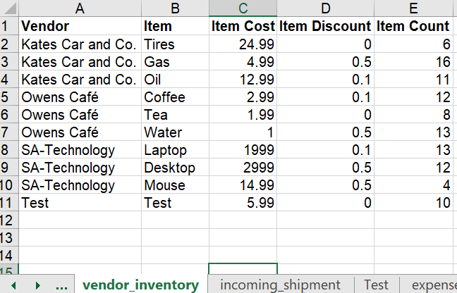
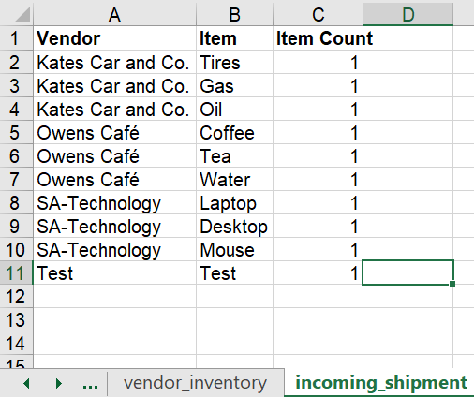
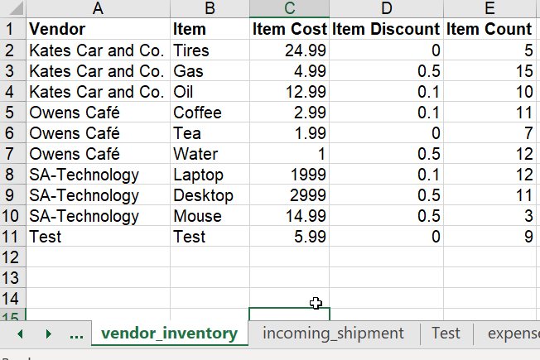
Stretch Goal: Update Inventory From Incoming Shipments

Slide 4

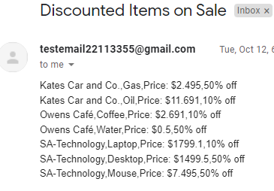
Stretch Goal: Email Client List Discounted Items

Slide 5
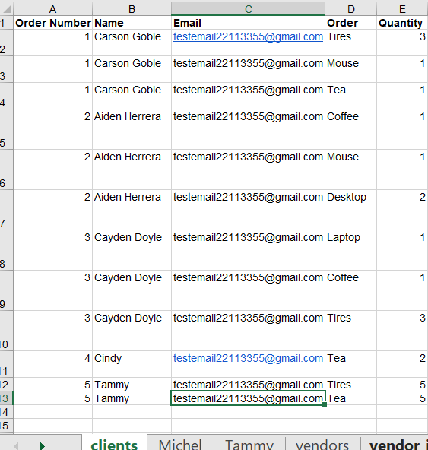
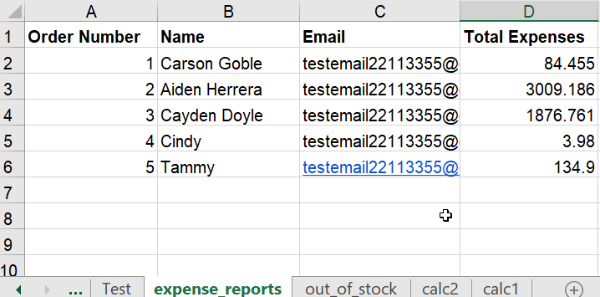
Feature: Total Expense Report

Slide 6

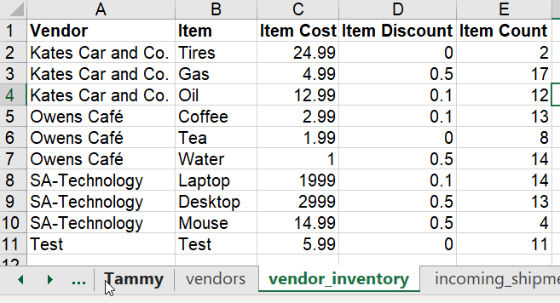

Feature: Out Of Stock

Slide 7
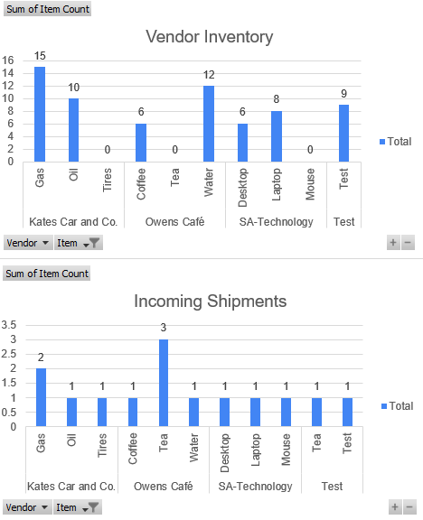
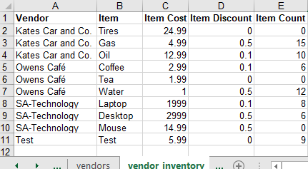
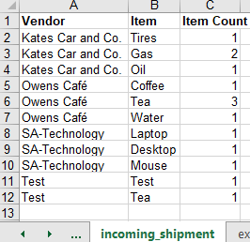
Feature: Automatic Updating Pivot Charts For Vendor Inventory And Incoming Shipments

